Slide 1
Strategic Planning Discussion
August 27, 2021
Notes:
Lisa
Test raising hand, typing in chat box. - yes or no, you are fired up to learn about leadership today.

Slide 2
AMSD History
Founded with the purpose to advocate for 8 suburban school districts.
Expanded to Metro districts with the addition of MPS and SPPS, become involved in an integration lawsuit
Launched Reimagine Minnesota in response to the Cruz- Guzman lawsuit
Hired Scott Croonquist as Executive Director AMSD serving 26 member districts
Conducted first Policy Conference- currently the Fall Conference
Launched Superinten-dent meetings in response to the Pandemic
Supported Districts in passing their local referendum
Serves 48 Districts, including Intermediate Districts and some outside the “Metro”
1974
1999
2000
2001
2002
2016
2020
2021

Slide 3
Strategic Planning Goal & Process
Create Strategic Plan
Operationalize
Planning
Gather and analyze data
To ensure all stakeholders are aligned towards the Vision/Mission and that resources are allocated only towards activities that will achieve that goal.
May/June | June/July 15 | July16 - September | October - ongoing
Overview of the strategic planning process Develop timeline Conduct audit of the current strategic plan and current state analysis (AMSD Staff) Identify Data sources Member district involvement Public education legislative action Other | Conduct Interviews with AMSD Executive and Legislative Committee and other key stakeholders Survey Members Analyze interview, survey and data sources | Refresh Vision and Mission Develop strategic Priorities Discuss belief statements Create metrics to assess progress Develop one year goals | Develop implementation plan Develop communication and approval plan Implement process to assess progress Communicate progress on a regular bases Assess quarterly

Slide 4
Vision
Why you do it
Lofty - Your aspirations
What the organization is reaching for
Attached to core values
Rarely changes
Board Responsibility
Mission
What you do
The core of the organization
Everything you do must attach to the mission
May revisit & change the mission
Board and staff responsibility
Strategic Priorities
How you do it
Fuel of the organization
They propel the organization forward
Operational plan is organized around these
Tactical plan
Staff Responsibility
Notes:
He who has a why can bear almost any how – Friedrich Nietzsche

Slide 5
Vision: Why does AMSD exist?
Current
Proposed
AMSD Intends to create:
A highly engaged, fully informed, and knowledgeable membership acting as a collective voice for each and every student
Education-friendly policy and funding improvements that enable each and every student to achieve and will end the opportunity and achievement gaps.
Proactive, strategic legislative efforts that result in:
Adequate funding and decreased mandates
Improvement in education policy with more local control and flexibility in resource allocation
Elimination of policies that are not effective or useful to districts
Increased access and efficiency through technology to disseminate information and advocate for AMSD’s mission.
Each and every student has access to an equitable and excellent public education.

Slide 6
Mission: What does AMSD do?
Current
Proposed
The mission of AMSD is to advocate for metropolitan school districts and advance legislation that supports student achievement.
Advocate for metropolitan school districts so they can innovate and lead the transformation of public education.

Slide 7
Strategic Directions: How does AMSD Support its Mission?
Current
Proposed
Advocate and lobby for funding and policies that respect local-control and enable districts to successfully meet the needs of each and every student
Develop internal connections and a collective voice, while fostering external partnerships, to provide for local control and flexibility in resource allocation.
Develop and engage members in our mission, utilizing technology, innovation and AMSD resources to provide research-based information and tools.
Support the work of Reimagine Minnesota to ensure that each and every student has the opportunity to attend a school that provides an equitable and excellent education that allows them to reach their full potential
Advocate for funding and policies that *respect local control and empower districts to meet the needs of each and every student
Create opportunities for school district leaders to collaborate, innovate, generate solutions, and share best practices.
Generate nonpartisan research, data and legislative updates that assist AMSD members to effectively advocate for our school districts and students.
Advance the work of Reimagine Minnesota
*for further discussion

Slide 8
What does AMSD Believe?
Minnesota’s future prosperity is dependent upon the success of each and every student
Public education must be the highest priority of state government
State education policy and resource allocation must recognize and support the unique needs of metropolitan districts
The collective and consistent voice of member districts is critical to achieving our mission.
*Should we include non-partisan

Slide 9
Next Steps
Create metrics to assess progress
Develop one year goals
Develop time line for board approval and implementation

Slide 10
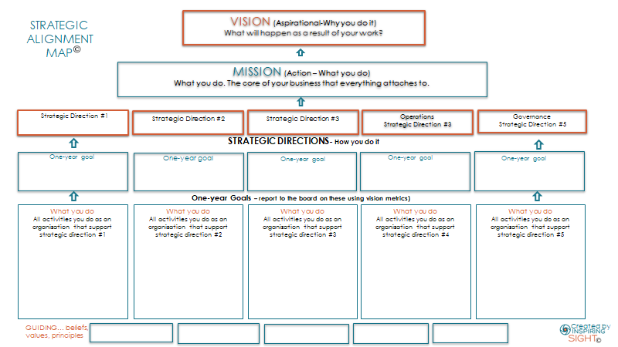
Notes:
Mary Kay

