Slide 1
BPS Screening Tools for Dyslexia
April 2019
Research, Evaluation & Assessment
David Heistad

Slide 2
International Dyslexia Association
Identifying Dyslexia
The key symptoms of dyslexia are problems with decoding or single word reading and/or poor reading fluency and poor spelling.
Phonological weaknesses or disorders, specific language-based difficulties, are usually the underlying cause of the literacy problems associated with dyslexia.
Comprehension may be impaired and writing skills will suffer if spelling is not mastered.
Language and vocabulary problems can cause comprehension difficulties that can become more severe over time as academic demands increase.
Poor readers may have weak vocabulary and background knowledge caused by reading less than average readers.
https://dyslexiaida.org/dyslexia-assessment-what-is-it-and-how-can-it-help/

Slide 3
BPS Kindergarten
Literacy Domains Assessed
Tool | Phonological Awareness | Alphabetic Principle | Comprehension | Vocabulary | Word Recognition
BEKA (Fall) | Beginning Sounds, Rhyming Letter Sounds | Letter Names, Letter Sounds | Oral Comprehension | Oral Vocabulary | Concept of a word, Sight Words
BAS (Winter) |  |  | Comprehension of connected text, Identify Instructional Level |  | Accuracy & Fluency
Note: Writing and spelling are assessed at the classroom level

Slide 4
BPS Grade 1
Literacy Domains Assessed
Tool | Phonological Awareness | Alphabetic Principle | Comprehension | Vocabulary | Word Recognition/Fluency
MPG (fall and spring) | Beginning Sounds, Rhyming, Letter Sounds | Letter Names | Comprehension of connected text | Vocabulary for K-5 levels | N/A
BAS (fall and winter) |  |  | Comprehension of connected text, Identify Instructional Level, Self Correction |  | Accuracy & Fluency (Oral Reading Rate)
Note: Writing and spelling are assessed at the classroom level

Slide 5
Grades 2-5
Literacy Domains Assessed
Tool | Phonological Awareness | Alphabetic Principle | Comprehension | Vocabulary | Word Recognition/Fluency
MAP (fall and spring) | Beginning Sounds, Rhyming, Letter Sounds | Letter Names | Comprehension of connected text | Vocabulary for K-8 levels | N/A
BAS (fall and spring) |  |  | Comprehension of connected text, Identify Instructional Level, Self Correction |  | Accuracy & Fluency (Oral Reading Rate)
Note: Writing and spelling are assessed at the classroom level

Slide 6
Additional Assessments for Dyslexia
Students who are below the 25th percentile on MAP reading and one grade level below on the BAS, have the following follow-up assessments:
  PRESS (U of M) Phonemic Awareness Inventory with phoneme segmentation, blending, and sound manipulation
  CORE (Consortium on Reaching Excellence) measures letter names, sounds, ability to read short vowel words and psuedo-words, low frequency spellings, and multi-syllabic words

Slide 7
BEKA: Standardized Assessment Used for Multiple Purposes
Summative Assessment for determining the success of pre-k interventions.
Screener at the beginning of the year for assisting differentiated instruction
Benchmark for pathway analysis and Milestone Metrics including narrowing the achievement gap
Pre-test for identifying teachers who “beat the odds” and to give “value-added” feedback.
    https://www.youtube.com/watch?v=O-e7xLs7_j4
    https://www.youtube.com/watch?v=0Sv9H8ULvUg
Tool for communicating with families
Screener for Dyslexia

Slide 8
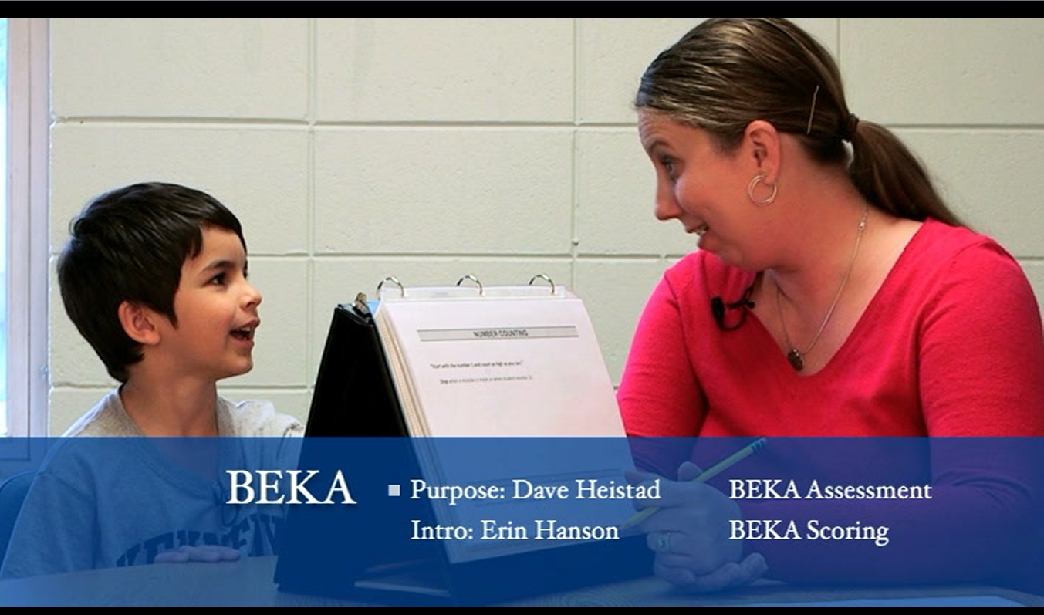
ALL BEKA Assessors are trained with standard instructions

Slide 9
Bloomington Early Kindergarten Assessment (BEKA)
Numeracy Items – Correlation with Grade 1 Fall MPG Math
NUMBER COUNTING r_{xy}= .512
Score 1 point for each number in sequence – up to 31.
Stop when a mistake is make and record highest correct number. ____/31
COUNTING OBJECTS r_{xy} =.436
Score 1 point for each correct set.
____apples (3) ____ watermelon (8) ____ carrots (15) _____/3
PATTERNS r_{xy} = .445
Score 1 point for each correct pattern.
____ AB pattern (scissors) ____ABC pattern (ball) ____ AAB pattern (red, circle, or ball) _____/3
NUMBER RECOGNITION r_{xy} = .436
Score 1 point for each number named correctly. (Put a slash through incorrect/ unknown numbers)
4 2 0 6 3 5 1 8 10 7 12 11 9 15 19 13 18 17 20 16 14 _____/21
NUMBER SEQUENCE r_{xy} = .536
Score 1 point for each number in correct sequence [Circle correct sequence(s)] _____/7
4, 5, 8, 11, 13, 16, 21
SIMPLE ADDITION r_{xy} = .526
Score 1 point if answer is correct: 4+2 = 6 _____/1

Slide 10
Bloomington Early Kindergarten Assessment (BEKA)
Literacy Items – Correlation with Grade 1 Fall MPG Reading
LETTER RECOGNITION r_{xy} = .474
Score 1 point for each letter named correctly. (Put a slash through incorrect/ unknown letters)
M P B S T A H E D C N I J F V L Y R X G W O Z K Q U _____/26
m p b s t a h e d c n I j f v l y r x g w o z k q u _____/26
SOUND RECOGNITION r_{xy} = .484
Score 1 point for each sound produced correctly. (Put a slash through incorrect/ unknown sounds)
m p b s t a h e d c n I j f v l y r x g w o z k q u _____/26
BEGINNING SOUNDS r_{xy} = .425
Score 1 point for each correct response. (check √ correct beginning sound)
Mud____ 2. Ball____ 3. Ten ____ 4. Soap ____ 5. hat ____ 6. Pig ____ _____/6
SIGHT WORDS r_{xy} = .565
Score 1 point for each correct response. (check √ correct word)
the ____ at ____ and ____ of____
see ____ in ____ is ____ on ____
you ____ it ____ like ____ go ____
do ____ my ____ can ____ am ____
me ____ we ____ no ____ up ____ _____/20

Slide 11
Bloomington Early Kindergarten Assessment (BEKA)
Literacy Items – Correlation with Grade 1 Fall MPG Reading
CONCEPTS OF PRINT r_{xy} = .521
Score 1 point for each correct response. (check √ each correct concept)
Shows front of the book ____
Shows where to begin reading ____
Shows left to right ____
Shows return sweep ____
Counts number of words ____ _____/5
RHYMING WORDS r_{xy} = .488
Score 1 point for each correct response. (check √ each correct word)
1) cat, sat, ____ 2) hop, top, ____ 3) bug, hug, ____
4) men, ten ____ 5) wig, dig, _____6) beat, meat, ____ _____/6
ORAL COMPREHENSION r_{xy} = .529
Transfer score from bottom of comprehension score sheet. _____/21
Total Literacy r_{xy} = .626
Total Numeracy r_{xy} = .632 Note: These are restricted range estimates

Slide 12
District Raw Score Distribution of
BEKA Literacy
57.1%
< 50 = “Not Proficient”
19.4%

Slide 13
BEKA Literacy Strand Proficiency Cut Scores
Total Literacy
  Alphabetic Principal (Letters + Concepts of Print) = 49
    Upper Case Proficiency = 24
    Lower Case Proficiency = 22
    Concepts of Print = 3
  Phonological Awareness (Sounds + Rhyming) = 20
    Beginning Sounds= 4
    Rhyming = 3
    Letter/Sound Recognition = 13
  Language (Sight Words + Oral Comprehension) = 14
    Sight Words = 1
    Oral Comprehension = 13

Slide 14
BEKA Literacy Strand Proficiency

Slide 15
Other Tools for Dyslexia Screening
See the National Center for Intensive Interventions for tools that meet standards of technical adequacy
  https://charts.intensiveintervention.org/chart/academic-screening

